Slide 1
Unit 1 Introduction to data Structure
Compiled By:
Ghanashyam BK

Slide 2
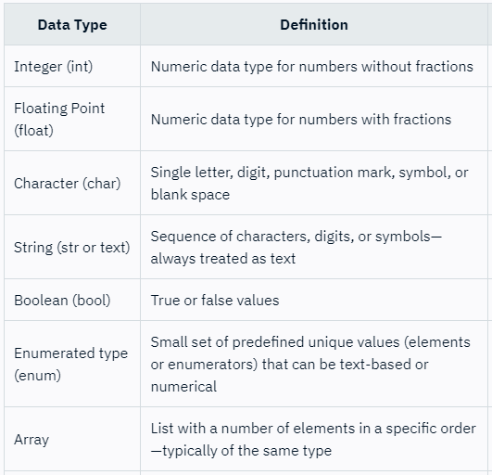
DataTypes
Data types are declarations for variables.
This determines the type and size of data associated with variables.
For example, int a;
Here, a is a variable of int (integer) type. The size of int is 4 bytes.

Slide 3
User Defined DataTypes
A user-defined data type is one that is derived from an existing data type.
The user-defined data types extend the primitive types that are already available in the programming language
Examples: Structure, Union and Typedef.
Structure
A structure is a user defined data type in C.
A structure creates a data type that can be used to group items of possibly different types into a single type.
Example:
struct student
{
char name[100];
int roll;
float marks;
}
Here, with this structure we can create our own defined data type in following way:
Struct student info;

Slide 4
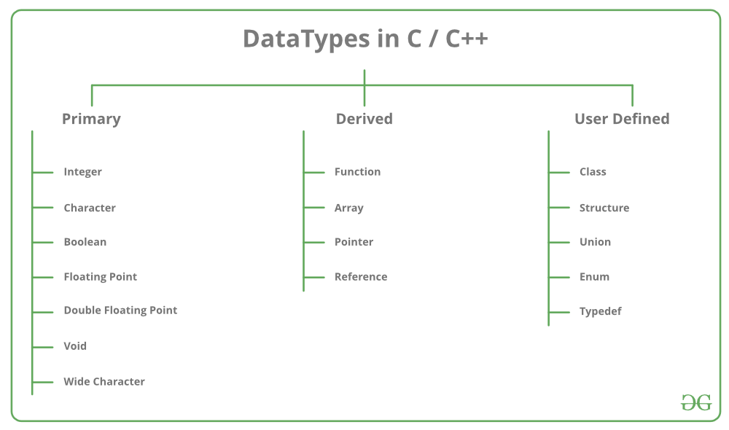
DataTypes in C/C++

Slide 5
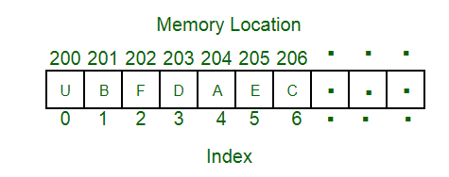
Data Structure
particular way of organizing data in a computer so that it can be used effectively.
The idea is to reduce the space and time complexities of different tasks
Example: we can store a list of items having the same data-type using the array data structure.

Slide 6
Types of Data Structures
Primitive data structure
The primitive data structures are primitive data types.
The int, char, float, double, and pointer are the primitive data structures that can hold a single value.
Non-primitive data structure
The non-primitive data structure is divided into two types:
Linear data structure
The arrangement of data in a sequential manner is known as a linear data structure.
The data structures used for this purpose are Arrays, Linked list, Stacks, and Queues.
In these data structures, one element is connected to only one another element in a linear form.
Non-linear data structure
When one element is connected to the 'n' number of elements known as a non-linear data structure.
The best example is trees and graphs. In this case, the elements are arranged in a random manner.

Slide 7
Types of Data Structures
Can also be classified as:
Static data structure:
It is a type of data structure where the size is allocated at the compile time. Therefore, the maximum size is fixed.
Dynamic data structure:
It is a type of data structure where the size is allocated at the run time. Therefore, the maximum size is flexible.

Slide 8
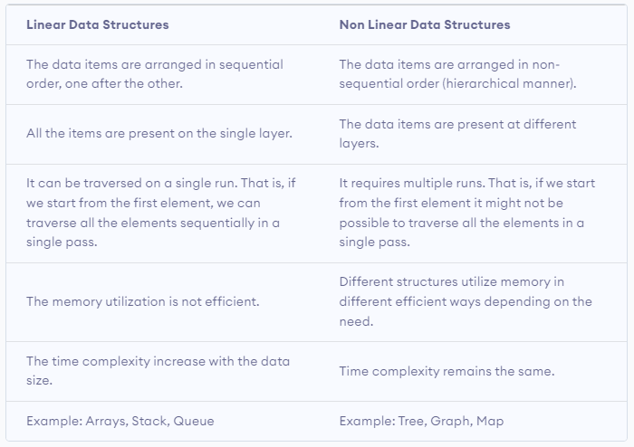
Linear vs Non linear Data Structure

Slide 9
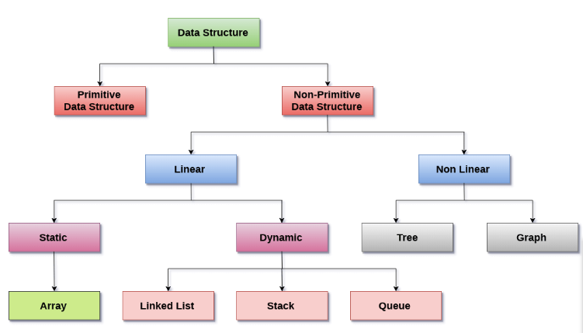
Data Structure Classifications

Slide 10
Data Structure operations
Searching:
We can search for any element in a data structure.
Sorting:
We can sort the elements of a data structure either in an ascending or descending order.
Insert:
We can also insert the new element in a data structure.
Update:
We can also update the element, i.e., we can replace the element with another element.
Delete:
We can also perform the delete operation to remove the element from the data structure.

Slide 11
Abstract Data Type
data structures that are not in-built are known as Abstract Data Type (ADT).
Abstract Data type (ADT) is a type (or class) for objects whose behavior is defined by a set of values and a set of operations.
An ADT tells what is to be done and data structure tells how it is to be done.
The definition of ADT only mentions what operations are to be performed but not how these operations will be implemented.
For example, a stack is an ADT (Abstract data type) which uses either arrays or linked list data structure for the implementation.

Slide 12
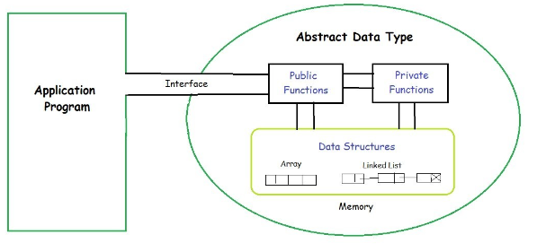
Abstract Data Type
The process of providing only the essentials and hiding the details is known as abstraction.

Slide 13
Importance of data structures
Processor speed:
To handle very large amout of data, high speed processing is required, but as the data is growing day by day to the billions of files per entity, processor may fail to deal with that much amount of data.
Data Search:
Consider an inventory size of 106 items in a store, If our application needs to search for a particular item, it needs to traverse 106 items every time, results in slowing down the search process.
Multiple requests:
If thousands of users are searching the data simultaneously on a web server, then there are the chances that a very large server can be failed during that process
in order to solve the above problems, data structures are used.
Data is organized to form a data structure in such a way that all items are not required to be searched and required data can be searched instantly.

Slide 14
Advantages of data structures
Efficiency:
Efficiency of a program depends upon the choice of data structures.
Reusability:
Data structures are reusable, i.e. once we have implemented a particular data structure, we can use it at any other place.
Implementation of data structures can be compiled into libraries which can be used by different clients.
Abstraction:
Data structure is specified by the ADT which provides a level of abstraction.
The client program uses the data structure through interface only, without getting into the implementation details.

Slide 15
Algorithms
procedure used for solving a problem or performing a computation.
act as an exact list of instructions that conduct specified actions step by step in either hardware- or software-based routines.
In mathematics and computer science, an algorithm usually refers to a small procedure that solves a recurrent problem.
Algorithms can be expressed as natural languages, programming languages, pseudocode, flowcharts and control tables

Slide 16
Good Algorithm
The following are the primary factors that are often used to judge the quality of the algorithms.
Time –
To execute a program, the computer system takes some amount of time. The lesser is the time required, the better is the algorithm
Memory –
To execute a program, computer system takes some amount of memory space. The lesser is the memory required, the better is the algorithm.
Accuracy –
Multiple algorithms may provide suitable or correct solutions to a given problem, some of these may provide more accurate results than others, and such algorithms may be suitable.

Slide 17
Commonly used data structures in algorithms
Arrays:
Arrays are a simple data structure that can be used to store collections of elements in contiguous memory locations.
They provide constant-time access to elements given their index but may be less efficient when adding or removing elements.
Linked Lists:
Linked lists are a data structure that consists of a sequence of nodes, where each node contains a value and a pointer to the next node in the sequence.
They can be used to efficiently add or remove elements at the beginning or end of the list but may be less efficient when accessing elements at a specific index.
Stacks:
Stacks are a data structure that follows the "last-in, first-out" (LIFO) principle, where the last element added to the stack is the first one to be removed.
They can be implemented using arrays or linked lists and are commonly used in recursive algorithms.

Slide 18
Commonly used data structures in algorithms
Queues:
Queues are a data structure that follows the "first-in, first-out" (FIFO) principle, where the first element added to the queue is the first one to be removed.
They can be implemented using arrays or linked lists and are commonly used in scheduling algorithms.
Trees:
Trees are a data structure that consists of nodes arranged in a hierarchical structure, where each node has a parent and zero or more children.
They can be used to efficiently search for or insert elements in a sorted collection.
Graphs:
Graphs are a data structure that consists of a set of vertices and edges connecting them.
They can be used to represent complex relationships between elements and are commonly used in network algorithms.

Slide 19
Dynamic Memory allocation in C
C Dynamic Memory Allocation can be defined as a procedure in which the size of a data structure (like Array) is changed during the runtime.
C provides some functions to achieve these tasks.
There are 4 library functions provided by C defined under <stdlib.h> header file to facilitate dynamic memory allocation in C programming.
They are:
malloc()
calloc()
free()
realloc()

Slide 20
Dynamic Memory allocation in C
C malloc() method
The “malloc” or “memory allocation” method in C is used to dynamically allocate a single large block of memory with the specified size.
It returns a pointer of type void which can be cast into a pointer of any form.
It doesn’t Initialize memory at execution time so that it has initialized each block with the default garbage value initially.
Syntax of malloc() in C
Ptr = (cast-type*)malloc(byte-size)
For Example:
Ptr = (int*)malloc(100*sizeof(int));
since the size of int is 4 bytes, this statement will allocate 400 bytes of memory. And, the pointer ptr holds the address of the first byte in the allocated memory.

Slide 21
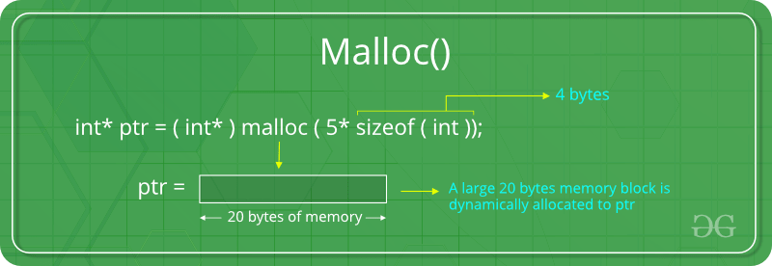
Dynamic Memory allocation in C

Slide 22
Dynamic Memory allocation in C
C calloc() method
“calloc” or “contiguous allocation” method in C is used to dynamically allocate the specified number of blocks of memory of the specified type.
It is very much similar to malloc() but has two different points and these are:
It initializes each block with a default value ‘0’.
It has two parameters or arguments as compare to malloc().
Syntax of calloc() in C
ptr = (cast-type*)calloc(n, element-size);
here, n is the no. of elements and element-size is the size of each element.
For Example:
ptr = (float*) calloc(25, sizeof(float));
This statement allocates contiguous space in memory for 25 elements each with the size of the float.

Slide 23
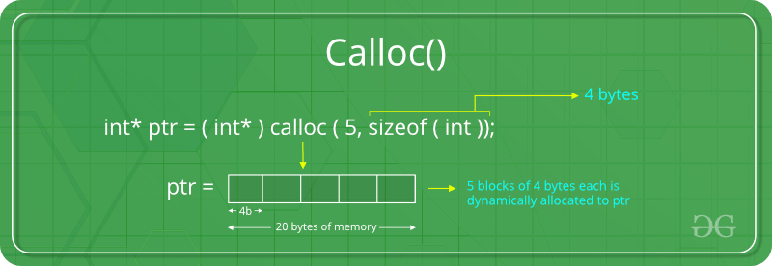
Dynamic Memory allocation in C

Slide 24
Dynamic Memory allocation in C
C free() method
“free” method in C is used to dynamically de-allocate the memory.
The memory allocated using functions malloc() and calloc() is not de-allocated on their own.
Hence the free() method is used, whenever the dynamic memory allocation takes place.
It helps to reduce wastage of memory by freeing it.
Syntax of free() in C
free(ptr);

Slide 25
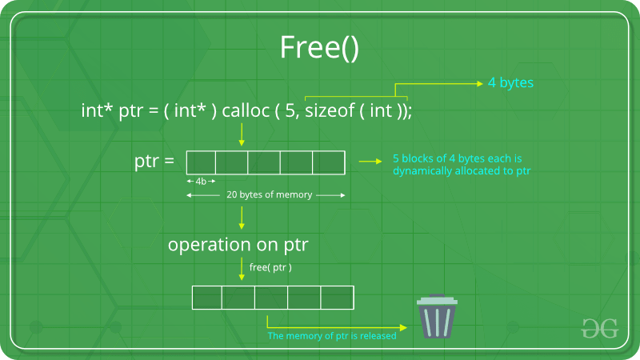
Dynamic Memory allocation in C

Slide 26
Dynamic Memory allocation in C
C realloc() method
“realloc” or “re-allocation” method in C is used to dynamically change the memory allocation of a previously allocated memory.
In other words, if the memory previously allocated with the help of malloc or calloc is insufficient, realloc can be used to dynamically re-allocate memory.
Re-allocation of memory maintains the already present value and new blocks will be initialized with the default garbage value.
Syntax of realloc() in C
ptr = realloc(ptr, newSize);
Where, ptr is reallocated with new size 'newSize'.

Slide 27
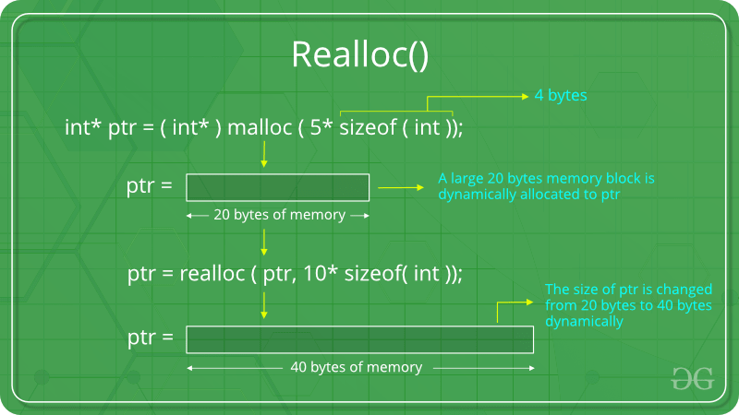
Dynamic Memory allocation in C

Slide 28
Time complexity of algorithm
the number of operations an algorithm performs to complete its task (considering that each operation takes the same amount of time).
The algorithm that performs the task in the smallest number of operations is considered the most efficient one in terms of the time complexity.
Example: Linear Search & Binary Search

Slide 29
Space complexity of algorithm
the total amount of memory space used by an algorithm/program, including the space of input values for execution
It is the memory required by an algorithm until it executes completely.
To find space-complexity, it is enough to calculate the space occupied by the variables used in an algorithm/program.
Space Complexity = Auxiliary space + Space used by input values
Where, Auxiliary space = just a temporary or extra space and it is not the same as space-complexity

Slide 30
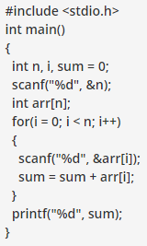
Space complexity of algorithm
In the given code, the array consists of n integer elements.
So, the space occupied by the array is 4 * n.
Also we have integer variables such as n, i and sum.
Assuming 4 bytes for each variable, the total space occupied by the program is 4n + 12 bytes.
Since the highest order of n in the equation 4n + 12 is n, so the space complexity is O(n) or linear.

Slide 31
Asymptotic notations
The commonly used asymptotic notations used for calculating the running time complexity of an algorithm is given below:
Big oh Notation (O)
asymptotic notation that measures the performance of an algorithm by simply providing the order of growth of the function.
This notation provides an upper bound on a function which ensures that the function never grows faster than the upper bound.
It is the formal way to express the upper boundary of an algorithm running time.
It measures the worst case of time complexity
Omega Notation (Ω)
It basically describes the best-case scenario which is opposite to the big o notation.
It is the formal way to represent the lower bound of an algorithm's running time.
It measures the best amount of time an algorithm can possibly take to complete or the best-case time complexity.
Theta Notation (θ)
The theta notation mainly describes the average case scenarios.
It represents the realistic time complexity of an algorithm.
It is the formal way to express both the upper bound and lower bound of an algorithm running time.

Slide 32
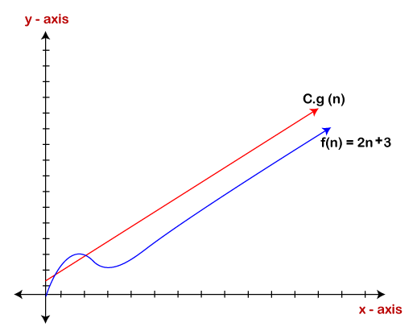
Big Oh Notation
If f(n) and g(n) are the two functions defined for positive integers, then f(n) = O(g(n)) as f(n) is big oh of g(n) or f(n) is on the order of g(n)) if there exists constants c and no such that:
f(n)≤c.g(n) for all n≥no
This implies that f(n) does not grow faster than g(n), or g(n) is an upper bound on the function f(n).
Example 1: f(n)=2n+3 , g(n)=n
Now, we have to find Is f(n)=O(g(n))?
To check f(n)=O(g(n)), it must satisfy the above condition:
Then, 2n +3 <= c.n
Let’s assume c = 5 and for all n the above condition is true.

Slide 33
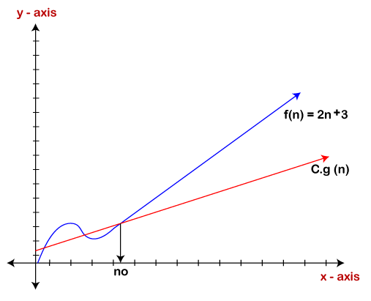
Omega Notation (Ω)
If f(n) and g(n) are the two functions defined for positive integers, then f(n) = Ω (g(n)) as f(n) is Omega of g(n) or f(n) is on the order of g(n)) if there exists constants c and no such that:
f(n)>=c.g(n) for all n≥no and c>0
Example: If f(n) = 2n+3, g(n) = n,
Now, we have to find Is f(n)= Ω (g(n))?
To check f(n)= Ω(g(n)), It must satisfy the above condition:
Then, 2n + 3 >= c.n
Let’s assume c = 1 and for all n the above condition is true.
Therefore, it is proved that g(n) is big omega of 2n+3 function.

Slide 34
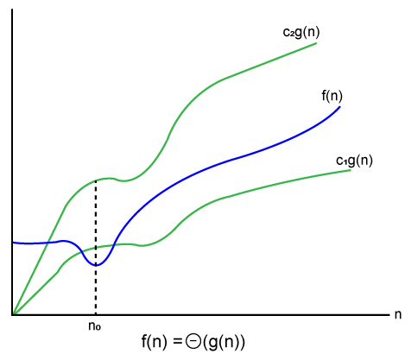
Theta Notation (θ)
Let f(n) and g(n) be the functions of n where n is the steps required to execute the program then:
f(n)= θg(n)
The above condition is satisfied only if when
c1.g(n)<=f(n)<=c2.g(n)
Example: If f(n) = 2n+3, g(n) = n,
Now, we have to find Is f(n)= θ (g(n))?
To check f(n)= θ(g(n)), It must satisfy the above condition:
Then, c1.n <= 2n + 3 <= c2.n
Let’s assume c1 = 1, c2 = 2 and for all n the above condition is true.
Hence, it is proved that f(n) is big theta of g(n).

Slide 35
Assignment-1
What do you understand by data structure and algorithm? Explain.
What kind of algorithms are considered to be the good algorithm?
What are the different types of datatypes available in C?
Explain different types of data structure in algorithm.
Explain the concept of dynamic memory allocation.
What is Abstract Data Type(ADT)? Explain.
Explain time and space complexity in an algorithm with example.
Explain Asymptotic notations of an algorithm.

